Slide 1
Natural Language Processing (NLP)
Lecture 4: Textual Corpus (Preparation), Edit Distance
Dr. Muhammad Taimoor Khan

Slide 2
Words or Tokens
May be defined differently depending on type of data and analysis.
A unit for analysis
Means something in a particular dataset
Required for analysis
E.g., the sentence from Brown University’s 1963-64 corpus has a sentence,
He stepped out into the hall, was delighted to encounter a water brother.
Has 13 words

Slide 3
Some languages like Chinese, Japanese and Thai do not use spaces to mark word boundaries and therefore, require alternate approaches for tokenization.
In Chinese, for example each character is called a hanzi and is pronounced like a syllable.
Chinese generally has 2.4 characters per word on average.
There are over 50,000 characters, though a comprehensive modern dictionary will rarely list over 20,000 in use. An educated Chinese person will know about 8,000 characters, but you will only need about 2-3,000 to be able to read a newspaper.

Slide 4
Punctuations as Tokens
Should we keep punctuations as tokens as well.
How to deal with abbreviations and acronyms (Ph.D., B.R.T., ltd.)
He stepped out into the hall , was delighted to encounter a water brother .
Has 15 words considering punctuations.
Preserving punctuations may be critical in case,
Want to know boundaries of token segments (comma, period, colon)
Identifying some meaning (exclamation, question mark, quotes)
Helps in identifying abbreviations and acronyms.

Slide 5
American Switchboard corpus 1990
The Switchboard corpus of American English telephone conversations between strangers was collected in the early 1990s;
It contains 2430 conversations
Averaging 6 minutes each conversation
240 hours of speech in total
3 million words spoken
Doesn’t have punctuations but has other disfluencies…

Slide 6
Fragments and Fillers
Considering an utterance from the dataset,
I do uh main- mainly business data processing
It has two types of disfluencies i.e.,
Fragments main-
Fillers or filled pauses uh
Should we keep disfluencies (available in the dataset)?
1) Depends on the type of application e.g., fragments and fillers may helps in identifying if someone is not clear or fluent in communication
2) Predicting the next word
3) Speech or speaker recognition

Slide 7
Capitalization
Should we be differentiating between They and they?
Normalizing capitalization may lead to treating US and us the same way (abbreviations).
Capitalization indicate proper nouns e.g., Karachi, Oxford.
Capitalization may mean to stress or emphasize on something.
It may also mean that someone is angrily grinding each word!
Case folding: convert everything to lowercase

Slide 8
Lemma
Lemma is a lexical form having same stem and the same sense
For example the words cats and cat have the same stem “cat”.
But do we really want to know if there was only one cat or more than one!!!
Again depends on the nature of application

Slide 9
Morphology
Morphology is the study of the way words are built-up of morphemes.
Morphemes are the small meaning bearing units that make up a word.
The most sophisticated methods for lemmatization involves complete morphological parsing of the word.

Slide 10
Morphemes have two parts
Stems:
The central morpheme of the word providing the main meaning e.g., cat in cats
Affixes:
Adding the additional meaning of various kinds .e.g, s in cats

Slide 11
Stemming
Lemmatization include all variations of simplifying a word
Stemming is a type of lemmatization. It is the chopping off the affixes to simplify a word.
Porter stemmer is a commonly used stemming approach.
For example,
automatic, automation, automation, automates -> automat

Slide 12
Sentence Segmentation
Sentence segmentation is another important step in text processing.
The most useful cues for segmenting a text into sentences are punctuation, like periods (.), question marks (?), exclamation points (!)
?, ! Are unambiguous markers for sentence boundaries.
Period (.) is ambiguous as it indicate boundary and abbreviations. At worst, it may indicate both.
For this reason, sentence tokenization and word tokenization may be addressed jointly.

Slide 13
In general, sentence tokenization methods work by building a binary classifier (based on a sequence of rules or on machine learning) that decides if a period is part of the word or is a sentence-boundary marker.
In making this decision, it helps to know if the period is attached to a commonly used abbreviation; thus, an abbreviation dictionary is useful.
State-of-the-art methods for sentence tokenization are based on machine learning

Slide 14
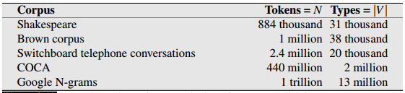
Text Corpus
Vocabulary or dictionary |V| i.e., count of unique words or tokens
Size of corpus N i.e., total words or tokens

Slide 15
Slangs
Slangs and shortened words are usually hard to normalize
The region should be known for slangs as they very depending upon the place and its people e.g.,
African American Vernacular English (AAVE) spoken by millions across America say
iont for I don’t
Talmbout for talking about

Slide 16
Others
Text may be translated from another language that may lose the context or the structural flow
Is the actual source available!!
It says a lot about the authors i.e., their views, age, gender, behavior, priorities
Do we have author’s information!!
Domain expert may be needed for content related to a specific genre e.g., finance, stock exchange, manufacturing etc.
Availability of expert or details of key terminologies!!

Slide 17
Edit Distance
Much of natural language processing is concerned with measuring how similar two strings are.
For example in spelling correction, the user typed some erroneous string—let’s say graffe
We want to know what the user meant. The user probably intended a word that is similar to graffe. Among candidate similar words,
grail, graf, giraffe
The word giraffe, differs by only one letter and seems intuitively to be more similar.

Slide 18
Edit Distance (for Sentence)
Another example comes from co-reference, the task of deciding whether two strings refer to the same entity:
Stanford President John Hennessy Stanford University President John Hennessy
Again, the fact that these two strings are very similar (differing by only one word) seems like useful evidence for deciding that they might be co-referent.

Slide 19
Edit distance gives us a way to quantify both of these intuitions about string similarity.
More formally, the minimum edit distance between two strings is defined as the minimum number of editing operations (operations like insertion, deletion, substitution) needed to transform one string into another.

Slide 20
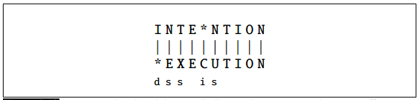
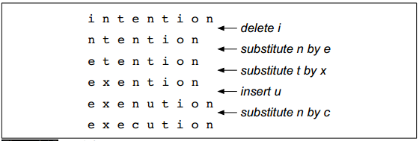
Example
The gap between intention and execution, for example, is 5 (delete an i, substitute e for n, substitute x for t, insert c, substitute u for n).

Slide 21
Simple Distance
We can also assign a particular cost or weight to each of these operations.
The Levenshtein simple distance between two sequences is the simplest weighting factor in which each of the three operations has a cost of 1

Slide 22
Levenshtein Distance
Levenshtein also proposed an alternative version of his metric in which each insertion or deletion has a cost of 1 and substitutions are not allowed.
This is equivalent to allowing substitution, but giving each substitution a cost of 2 since any substitution can be represented by one insertion and one deletion.
Using this version, the Levenshtein distance between intention and execution is 8.

Slide 23
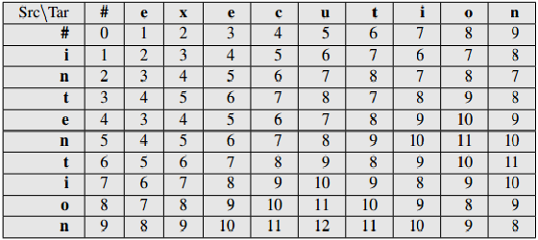
Levenshtein Distance
Cost of insertion and deletion is 1
Cost of substitution is 2

Slide 24
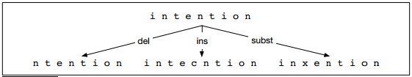
Minimum Edit Distance (A search operation)
We can think of this as a search task, in which we are searching for the shortest path—a sequence of edits—from one string to another.
However, its too large as a search space to find all possibilities and therefore, the shortest path to a state is remembered.
It is addressed as providing solutions to many small problems

Slide 25
How to find Min Edit Distance!
We need to define the following,
Initial state: Source string
Operations: Insertion, deletion, substitution
Goal State: Target string
Path Cost (Objective function): Number of edits (to be minimized)

Slide 26
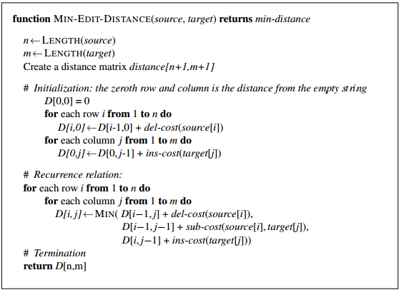
Minimum Edit Distance Algorithm

Slide 27
Applications
Spelling correction
Closest sentence in machine translation
Gene sequences in computational biology
Query string (suggestions)
Query string (results)

Slide 28
Quiz 1 (Home Quiz)
Write code for minimum edit distance
The user may provide any source and target strings
The user may provide any cost for each operation with default costs as levenshtein distance
Compile your code and results in a single word document
Deadline: 12th Feb
13th Feb: 10% penalty
14th Feb: 20% penalty
15th Feb: 30% penalty
After that Not Acceptable

